Slide 1
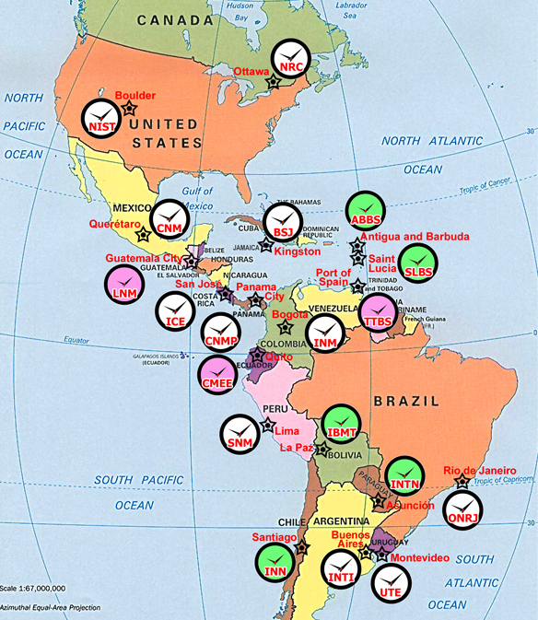

The SIMT Time Scale
J. Mauricio López R.
Centro Nacional de Metrologia, CENAM, El Marques, Qro. Mexico

Slide 2
The SIMT Time Scale
J. Mauricio López R.
Centro Nacional de Metrologia, CENAM, El Marques, Qro. Mexico
OUTLINE
1. Motivations
2. The SIM Time Network (SIMTN) concept
3. The SIM time scale (SIMT)
4. SIMT Disciplined Oscillators

Slide 3
The SIMT Time Scale
J. Mauricio López R.
Centro Nacional de Metrologia, CENAM, El Marques, Qro. Mexico
OUTLINE
✓
1. Motivations
2. The SIM Time Network (SIMTN) concept
3. The SIM time scale (SIMT)
4.SIMT Disciplined OScillators

Slide 4
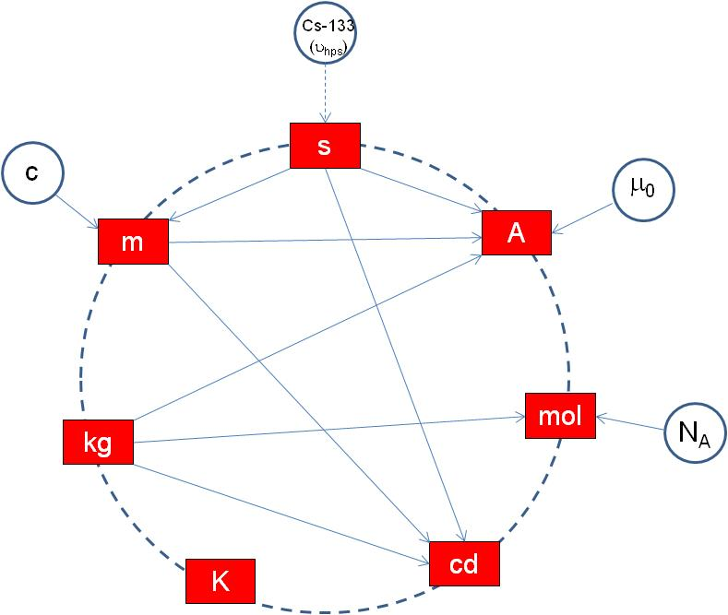

The second: strategic unit for the SI and for the economy
Scientific and fundamental research
Technological and practical applications
The current SI
Time is the most accurate measurement
TIME
The most measured physical quantity

Slide 5
The SIMT Time Scale
J. Mauricio López R.
Centro Nacional de Metrologia, CENAM, El Marques, Qro. Mexico
OUTLINE
1. Motivations
✓
2. The SIM Time Network (SIMTN) concept
3. The SIM time scale (SIMT)
4. SIMT Disciplined Oscillators

Slide 6
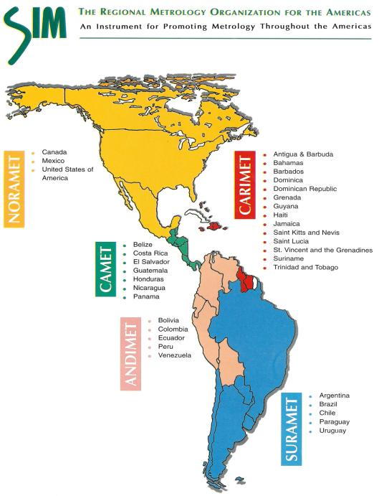

TIME AND FREQUENCY METROLOGY WORKING GROUP
Working to support time and frequency metrology throughout the Americas
34 NMIs
3 NMIs
14 NMIs
7 NMIs
5 NMIs
5 NMIs

Slide 7
TIME AND FREQUENCY METROLOGY WORKING GROUP
Working to support time and frequency metrology throughout the Americas
Current SIMTN members
22
✓
✓
✓
✓
✓
✓
✓
✓
✓
✓
✓
✓
✓
✓
✓
✓
✓
✓
✓
✓
✓
✓

Slide 8

TIME AND FREQUENCY METROLOGY WORKING GROUP
Working to support time and frequency metrology throughout the Americas
Current SIMTN members
22

Slide 9
Clock A
Clock B

Slide 10
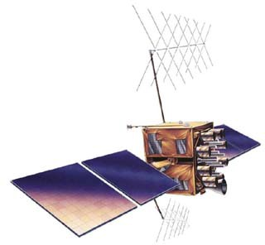
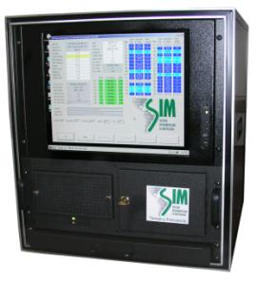
Clock A
GPS satellite
Measuring system A
Measuring system B
Clock B

Slide 11
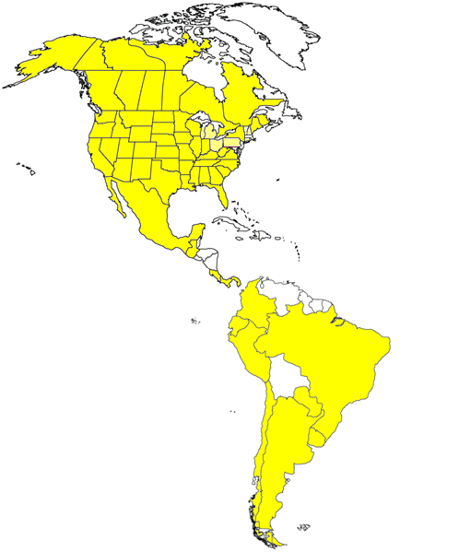
Clock A
GPS satellite
Measuring system A
GPS –Clock A
Measuring system B
GPS – clock B
Clock B
Time of the day
Time of the day

Slide 12
SIMTN servers
NRC
Clock A
NIST
Measuring system A
CENAM
GPS –Clock A
Measuring system B
GPS – clock B
Clock B
Time of the day
Time of the day

Slide 13
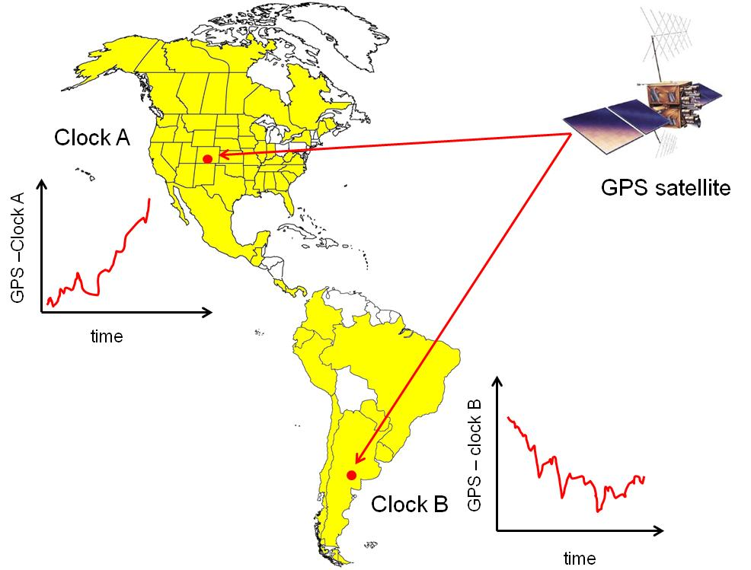
GPS – clock B
Clock A – Clock B ± u
GPS –Clock A
Time of the day
Time of the day
time
(Clock A – S) – (Clock B – S) = (Clock A – Clock B) + (d_{SA} – d_{SB})

Slide 14
links in the SIMTN
CENAM
LNM
ICE
NIST
N_{C} number of bilateral comparisons
CENAMEP
N number of laboratories in the network
NRC
SIC
For
N=22
there are
N_{C} = 231 !
bilateral comparisons
SLBS
ONRJ
BSJ
INDP
INTI
INTN
UTE

Slide 15
links in the SIMTN
CENAM
LNM
ICE
NIST
N_{C} number of bilateral comparisons
CENAMEP
N number of laboratories in the network
NRC
SIC
For
N=22
there are
N_{C} = 231 !
bilateral comparisons in
REAL TIME
SLBS
ONRJ
BSJ
INDP
INTI
INTN
UTE

Slide 16
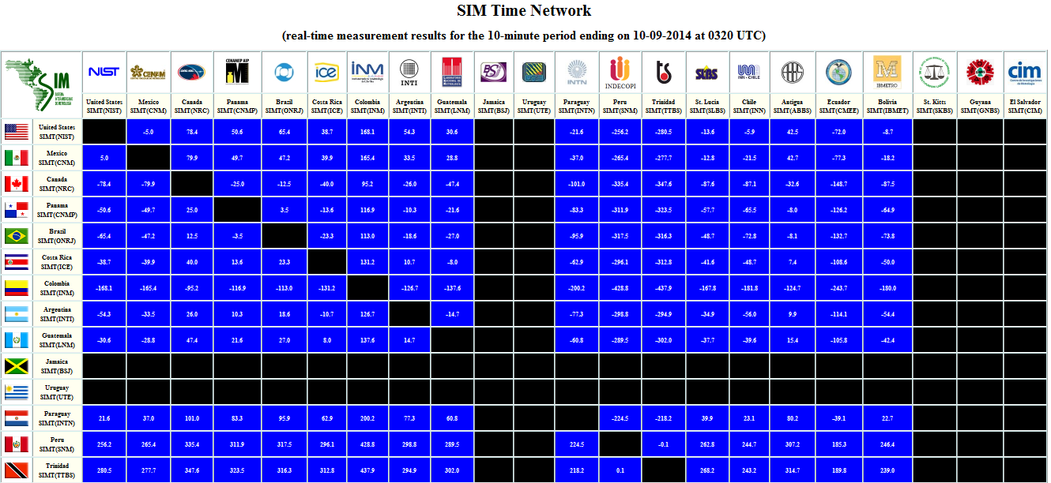
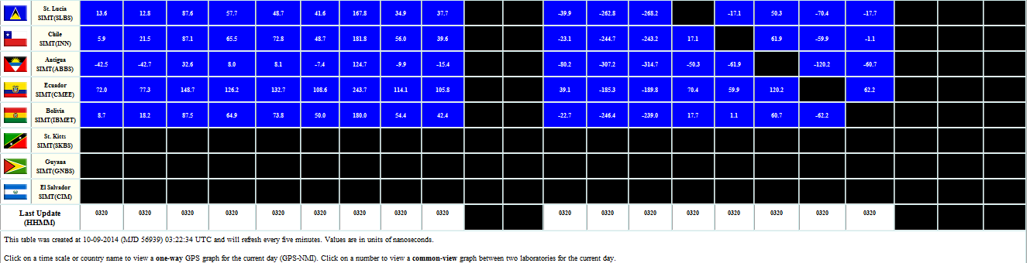
http://www.tf.nist.gov/sim

Slide 17
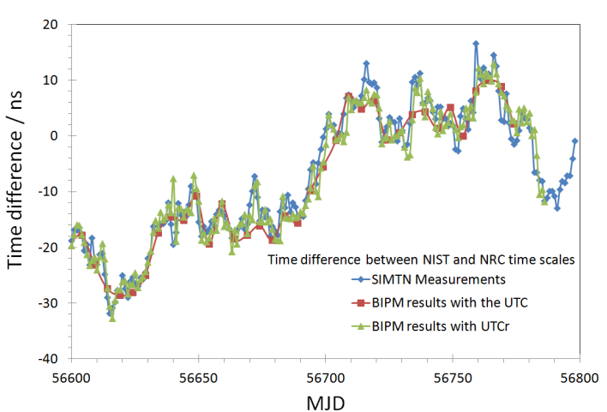

Slide 18
The SIMT Time Scale
J. Mauricio López R.
Centro Nacional de Metrologia, CENAM, El Marques, Qro. Mexico
OUTLINE
1. Motivations
2. The SIM Time Network (SIMTN) concept
✓
3. The SIM time scale (SIMT)
4. SIMT Disciplined OScillators

Slide 19
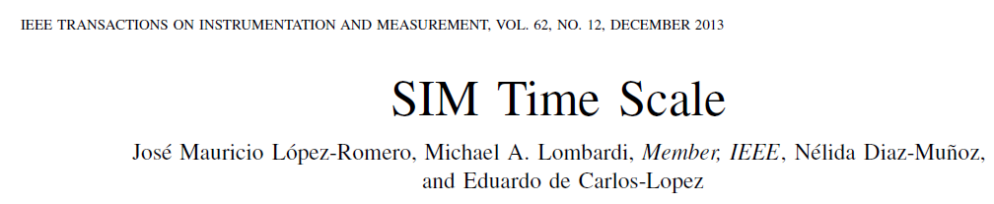
The SIM Time Scale, SIMT

Slide 20
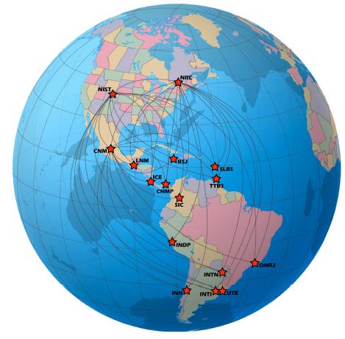
The SIM Time Scale, SIMT
∼ 30 Cesium beam clocks
9 Active Hydrogen Masers
1 Cs fountain clock (NIST)
2 Cs fountain clocks in progress
(NRC and CENAM)
4 ensemble time scales
(NRC, NIST, CENAM and ONRJ)

Slide 21
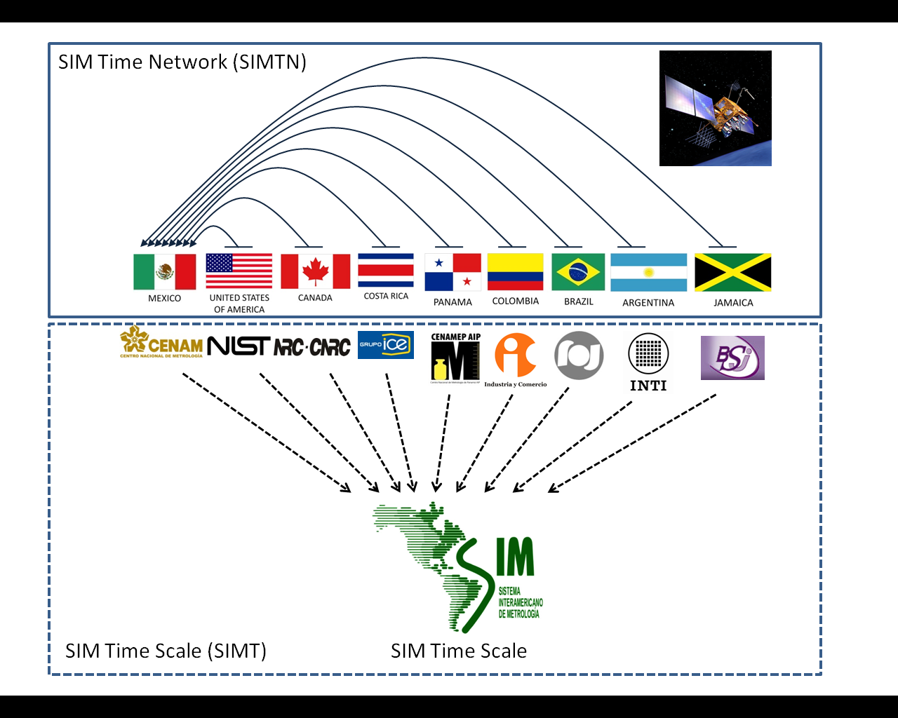
The SIM Time Scale, SIMT

Slide 22
The SIM Time Scale, SIMT
1.57542 GHz (L1 carrier)
GPS satellites
SIMT Computer (CENAM)
(reads SIMTN data feeds, runs SIMT algorithms, generates SIMT every hour)
GPS antenna
SIMTN data feeds (HTTP)
SIMT(k)
(clock or time scale)
8-channel GPS Receiver
FTP
(new data every hour)
10 MHz
1 pps
1 pps
SIMTN Web Server (NIST)
(publishes comparisons every 10 minutes)
(publishes SIMT every hour)
FTP
FTP Server (NIST)
(processes CVGPS and AVGPS data)
Time Interval Counter
New data every 10 minutes
FTP
FTP Server (CENAM)
(processes CVGPS and AVGPS data)
SIMTN Web Server (CENAM)
(publishes comparisons every 10 minutes)
SIMTN Computer
FTP
FTP Server (NRC)
(processes CVGPS and AVGPS data)
SIMTN Web Server (NRC)
(publishes comparisons every 10 minutes)
k-th member of SIMTN
(18 members)

Slide 23
A NEW ALGORITHM FOR CLOCK WEIGHTS
FOR THE SIM TIME SCALE
Taylor series expansion on the predicted time difference of clock k respect to SIMT
Time difference between clock k and SIMT at the time t (0th order aproximation)
Correction due to sistematic frequency difference between clock k and SIMT (1st order aproximation)
Prediction of the time difference between clock k and SIMT at the future time t+τ
Correction due to non constant (linear) frequency difference between clock k and SIMT (2th order aproximation)

Slide 24
A NEW ALGORITHM FOR CLOCK WEIGHTS
FOR THE SIM TIME SCALE
Averaging
Time difference between clock k and SIMT at the current time t+τ
Prediction of the time difference between clock j and SIMT made at the past time t
Time difference between clock j and clock k at the time t+τ

Slide 25
A NEW ALGORITHM FOR CLOCK WEIGHTS
FOR THE SIM TIME SCALE
Since February, 2012

Slide 26
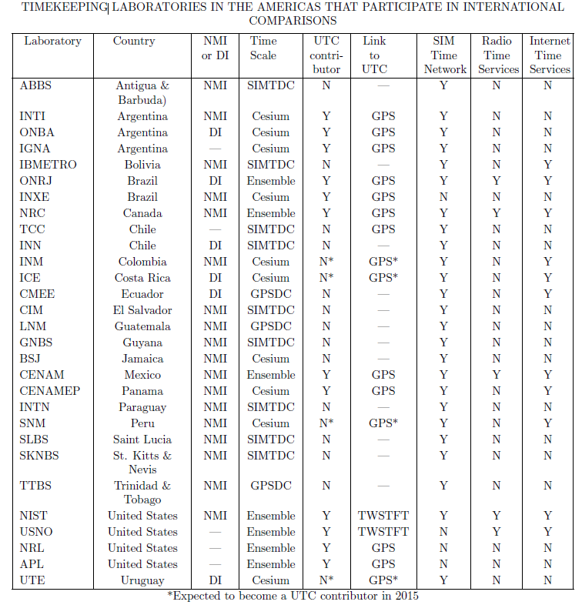

Slide 27
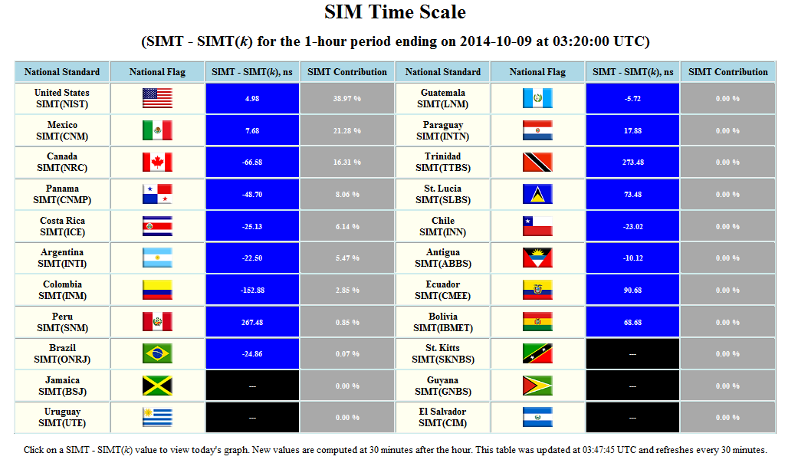
The SIM Time Scale, SIMT

Slide 28
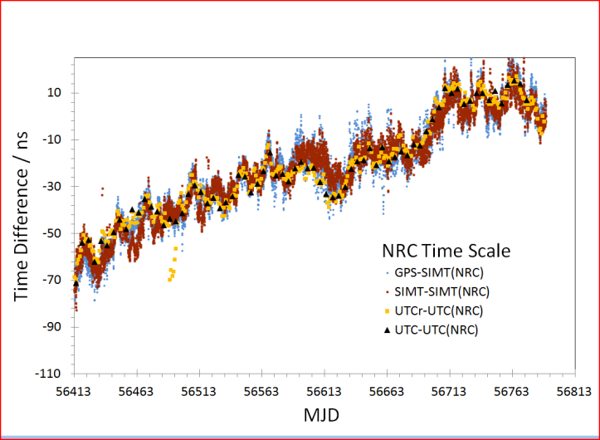
The SIM Time Scale, SIMT

Slide 29
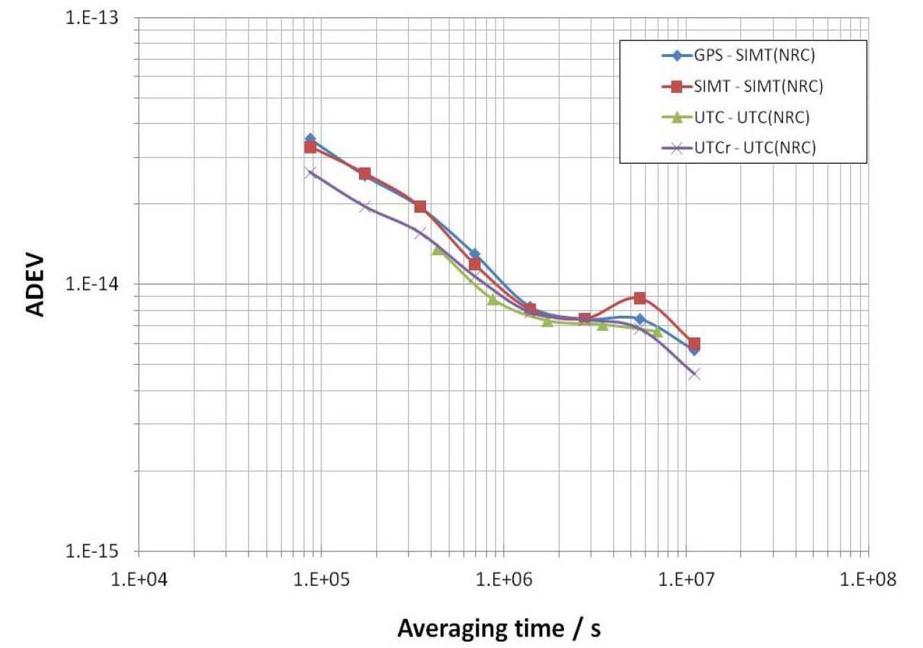
The SIM Time Scale, SIMT

Slide 30
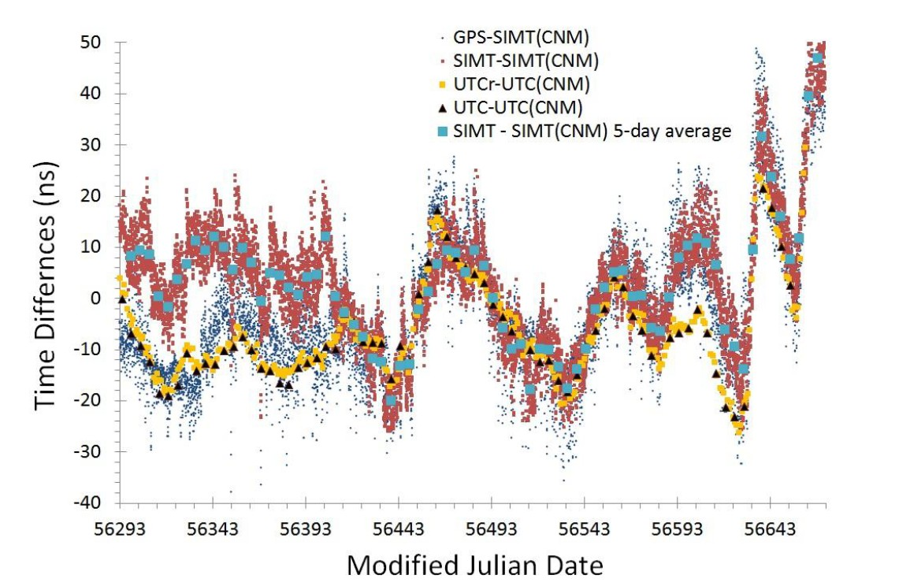
The SIM Time Scale, SIMT

Slide 31
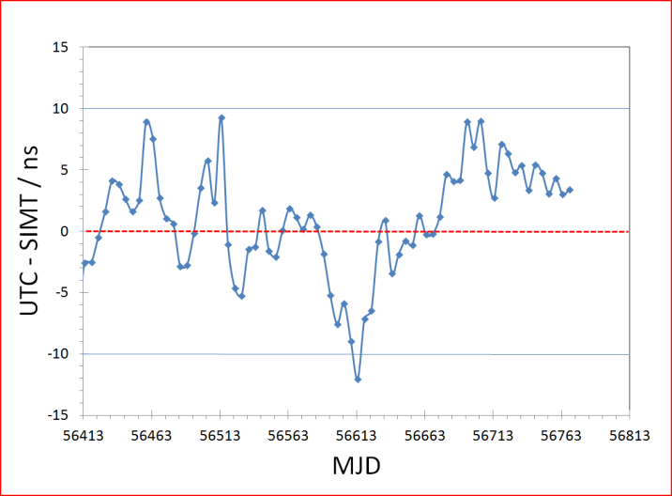
The SIM Time Scale, SIMT

Slide 32
The SIMT Time Scale
J. Mauricio López R.
Centro Nacional de Metrologia, CENAM, El Marques, Qro. Mexico
OUTLINE
1. Motivations
2. The SIM Time Network (SIMTN) concept
3. The SIM time scale (SIMT)
✓
4. SIMT Disciplined Oscillators

Slide 33
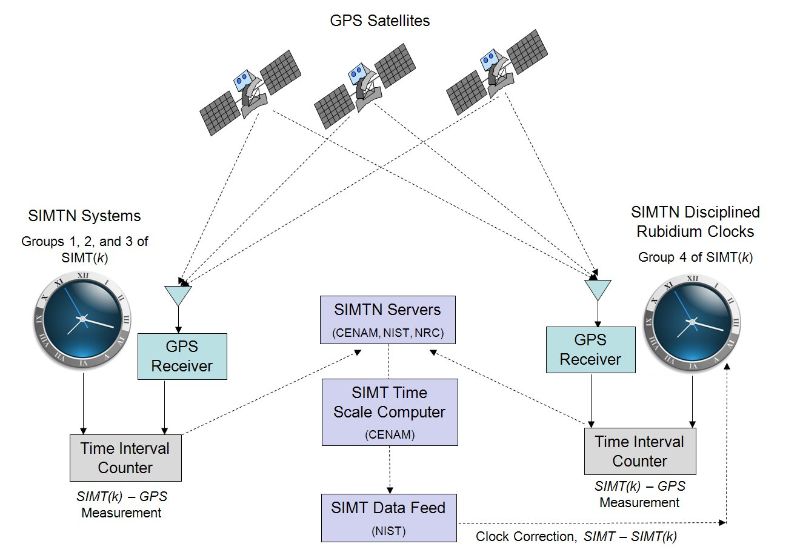

Slide 34
Saint Lucia Bureau Standards (before automated control)

Slide 37
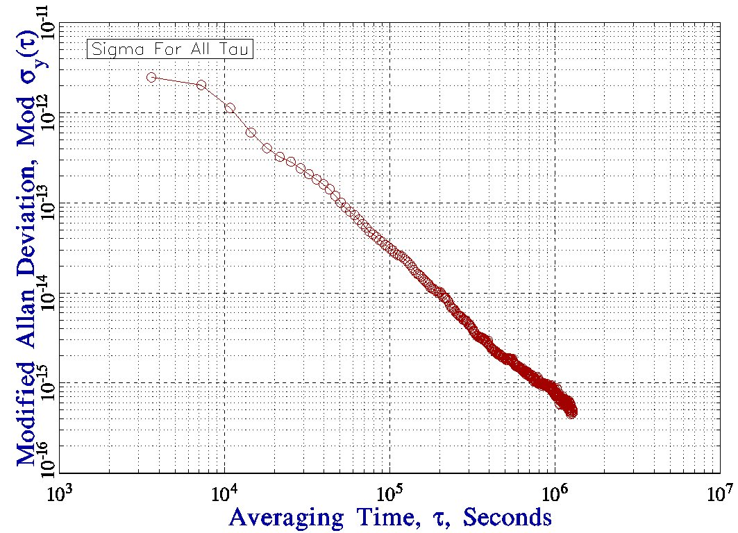

Slide 38
The SIMT Time Scale
J. Mauricio López R.
Centro Nacional de Metrologia, CENAM, El Marques, Qro. Mexico

